Slide 1
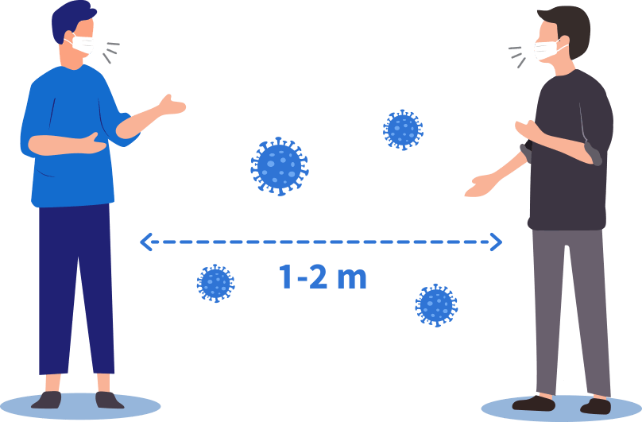
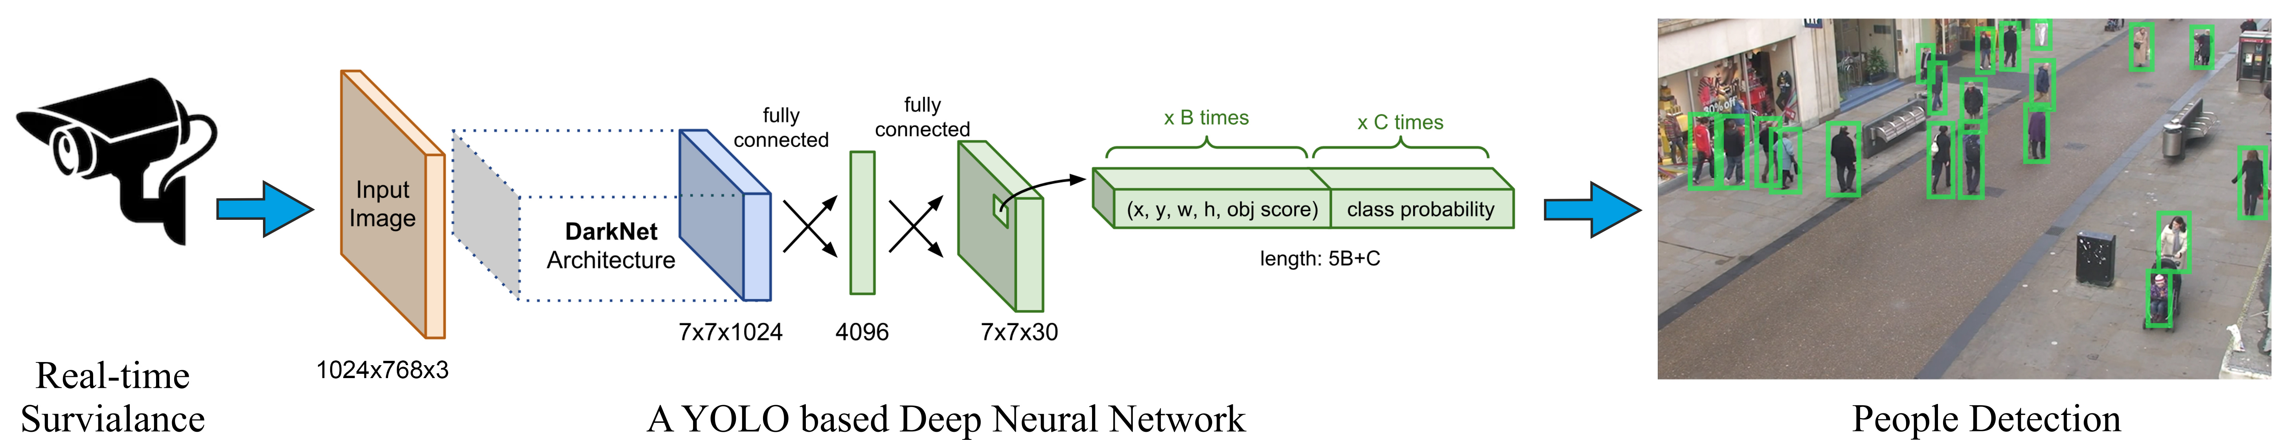
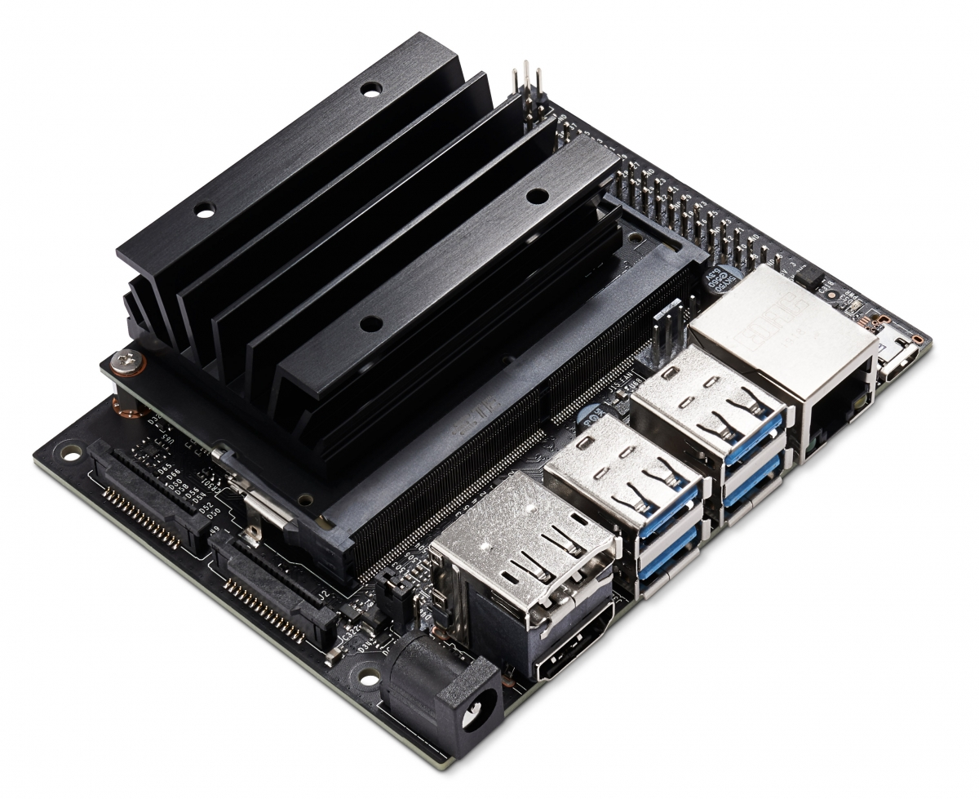
AI-powered smart social distancing detector using Nvidia Jetson NanoB01
Theivaprakasham H
CB.EN.P2CEN20026
Project Guide: Mr. Sajith Variyar V. V.

Slide 2

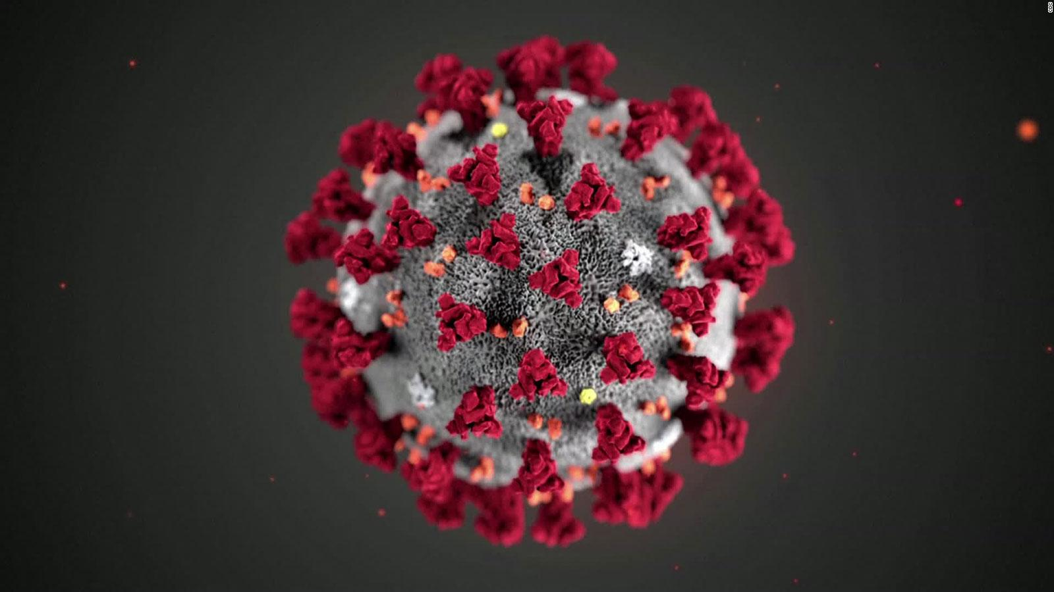
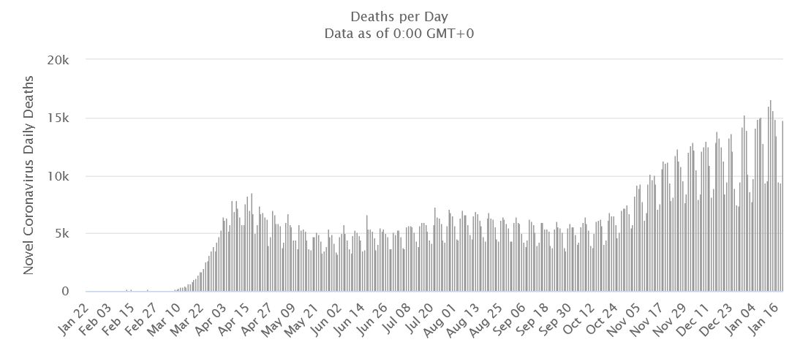
Introduction
Cases 96.2M |  | Deaths 2.06M
Deadly Virus Covid19

Slide 3
Literature Review
Keniya and Mehendale (Keniya and Mehendale, 2020) proposed a new architecture named SocialdistancingNet-19 for detecting the frame of a person and displaying labels, they are marked as safe or unsafe with an accuracy of 92.8 %.
Rusli et al., (Rusli et al., 2020) proposed a MySD system (My Safe Distance) that leverages smart phone hardware features that typically has Bluetooth transceiver as well GPS to determine safe distance and required level compliance.
Ahamad et al., 2020 (Ahamad et al., 2020) suggested a system for the identification of individuals in the areas of interest using the Single Shot Single Multibox Detector of MobileNet (SSD) and the Image processing OpenCV library.
Hou et al.,(Hou et al., 2020) presents a methodology by employing YOLOv3 algorithm for pedestrian detection and to calculate the distance between them using a video feed.

Slide 4
Problem Definition
Continuous Lockdown measures cannot be the solution for sustainability and the economics of the world
Need for the alternative monitoring system based on social distancing to prevent the spread of CoVid19 and economic revival
Need for low-cost affordable and reliable monitoring system
Application of AI technology on the concept of social distancing

Slide 5
Objectives
To explore capabilities of NVIDIA Jetson Nano B01 Developer Board for AI
Exploring different YOLO architectures for Object Detection
Designing Social Distancing Detector using the YOLO architecture
Testing the deployablity of our detector in both real-time and recorded videos

Slide 6
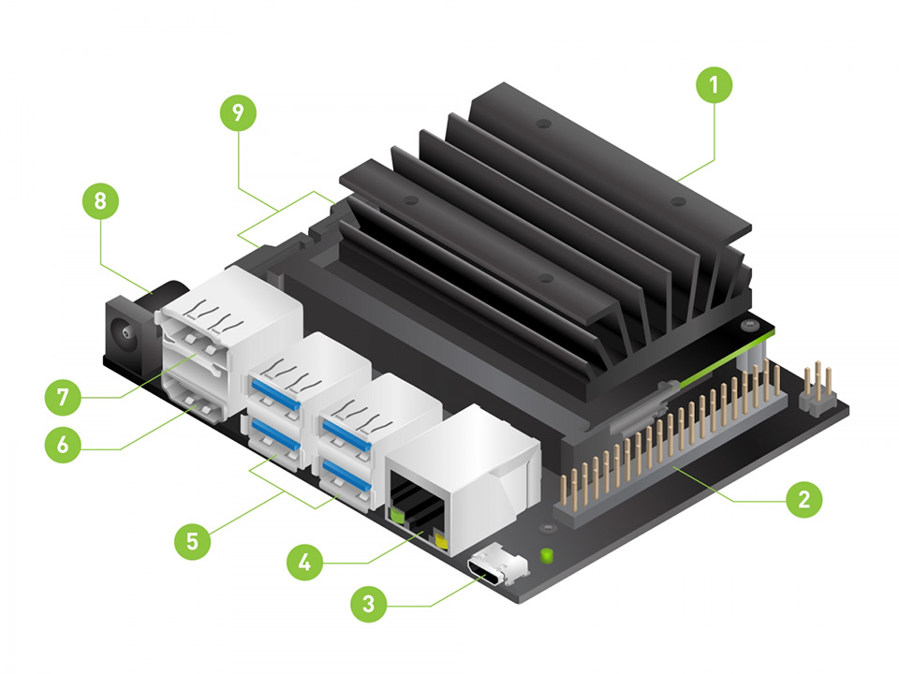
Methodology
Nvidia Jetson Nano B01
Micro SD card slot
40-GPIO pin expansion header
Micro USB port: for 5V power input or for USB data transmission
Gigabit Ethernet port: 10/100/1000Base-T auto-negotiation
4x USB 3.0 port
HDMI output port
DisplayPort connector
DC jack: for 5V power input
2x MIPI CSI camera connector

Slide 7
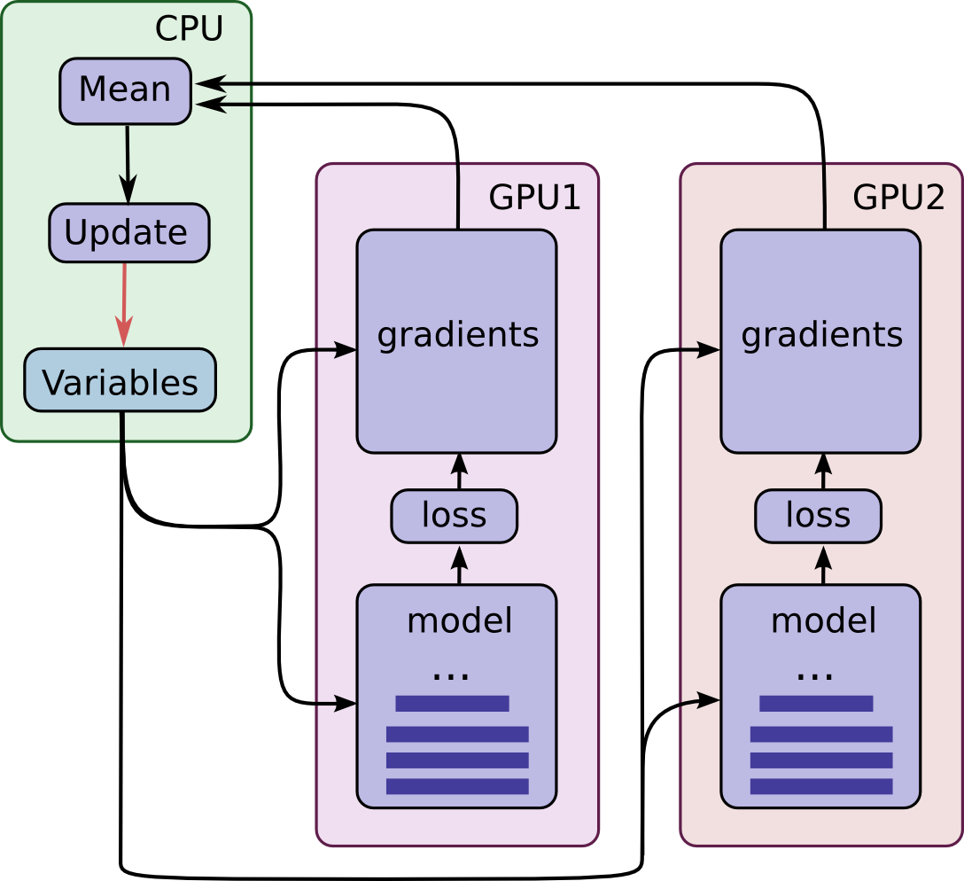
Methodology
GPU | 128-core Maxwell
CPU | Quad-core ARM A57 @ 1.43 GHz
MEMORY | 4 GB 64-bit LPDDR4 25.6 GB/s
STORAGE | Micro SD card
VIDEO ENCODER | 4K @ 30 | 4x 1080p @ 30 | 9x 720p @ 30 (H.264/H.265)
VIDEO DECODER | 4K @ 60 | 2x 4K @ 30 | 8x 1080p @ 30 | 18x 720p @ 30 (H.264/H.265)
CAMERA | 2x MIPI CSI-2 DPHY lanes
CONNECTIVITY | Gigabit Ethernet, M.2 Key E expansion connector (Recommendation: AC8265 Dual-mode NIC)
DISPLAY | HDMI and DP
USB | 4x USB 3.0, USB 2.0 Micro-B
EXTENSION INTERFACES | GPIO, I2C, I2S, SPI, UART

Slide 8
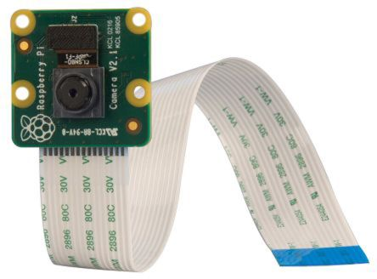
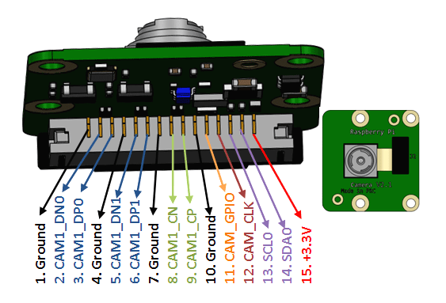
Methodology
Raspberry Pi Camera Module v2
Sensor: Sony IMX219PQ CMOS image sensor
Resolution: 8-Megapixel
Video formats: 1080p30, 720p60 and 640x480p90 resolutions

Slide 9
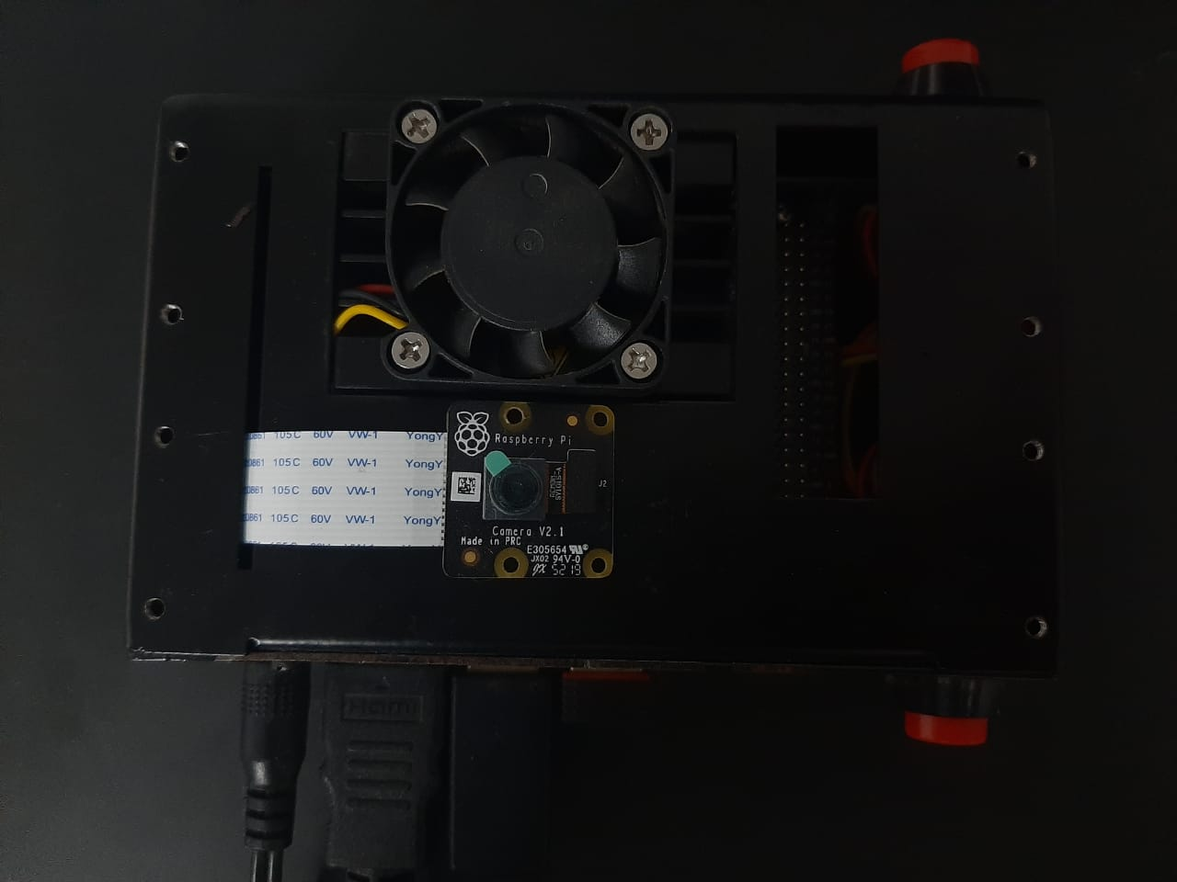
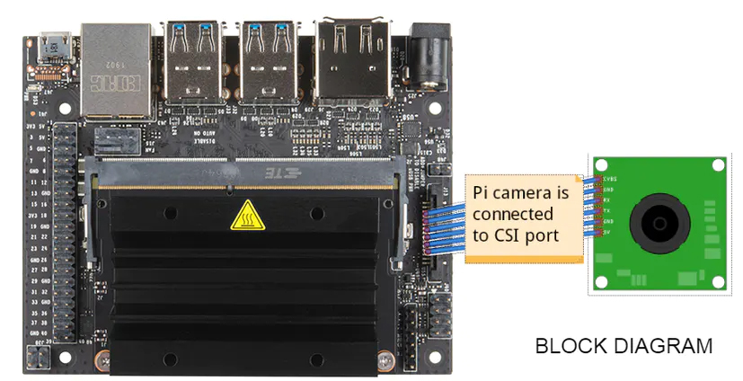
Methodology
Nvidia Jetson Nano B01 connected to Raspberry Pi Camera Module v2

Slide 10
Methodology
Total Development cost
Components | Cost
NVIDIA Jetson Nano B01 | Rs.9000
5V 4A Power Supply | Rs.350
WiFi Dongle | Rs.270
Wireless Mouse and Keyboard | Rs.450
Raspberry Pi v2 8MP Camera with CSI Connector | Rs.1500
Total Cost | Rs. 11570
Components | Cost
NVIDIA Jetson Nano B01 | Rs.9000
5V 4A Power Supply | Rs.350
WiFi Dongle | Rs.270
Wireless Mouse and Keyboard | Rs.450
Raspberry Pi v2 8MP Camera with CSI Connector | Rs.1500
Total Cost | Rs. 11570

Slide 11
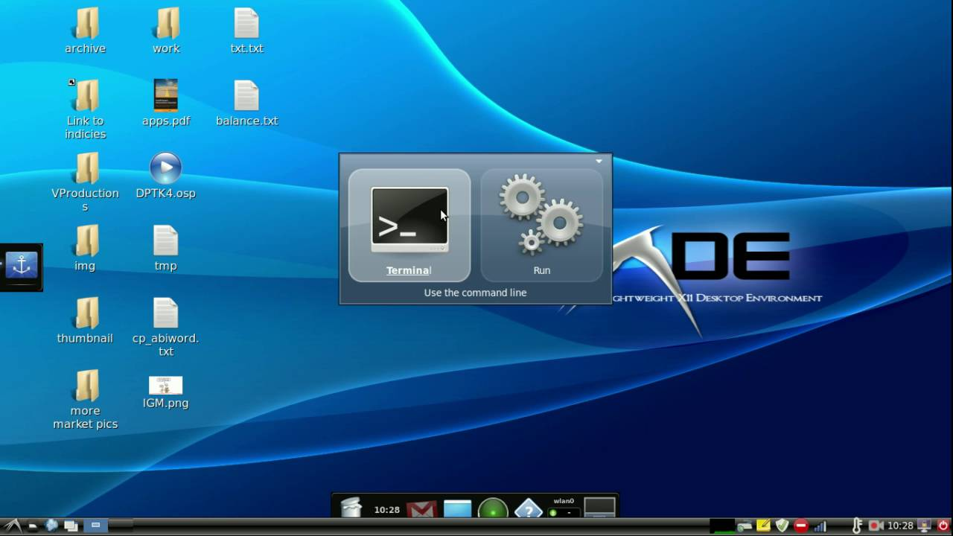
Methodology
Operating system: Ubuntu 18.0 LXDE
Dependencies
OpenCV==4.5 (with GPU cuDNN Enabled)
Numpy==1.16.1
Scipy==1.6.0
Imutils==0.5.4
Argparse==1.4.0
PyCuda
Pre-trained models (11)
Yolov3-spp, Yolov3-288, Yolov3-416, Yolov3-608, Yolov3-tiny-228, Yolov3-tiny-416, Yolov3-tiny-608, Yolov4-288, Yolov4-608, Yolov4-tiny288 and Yolov4-tiny-416
https://github.com/artynet/darknet-alexeyAB#pre-trained-models

Slide 12
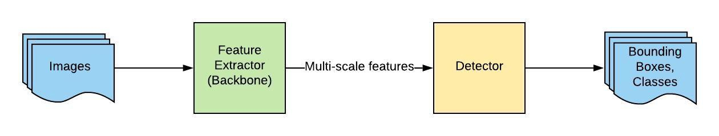
Methodology
Workflow

Slide 13
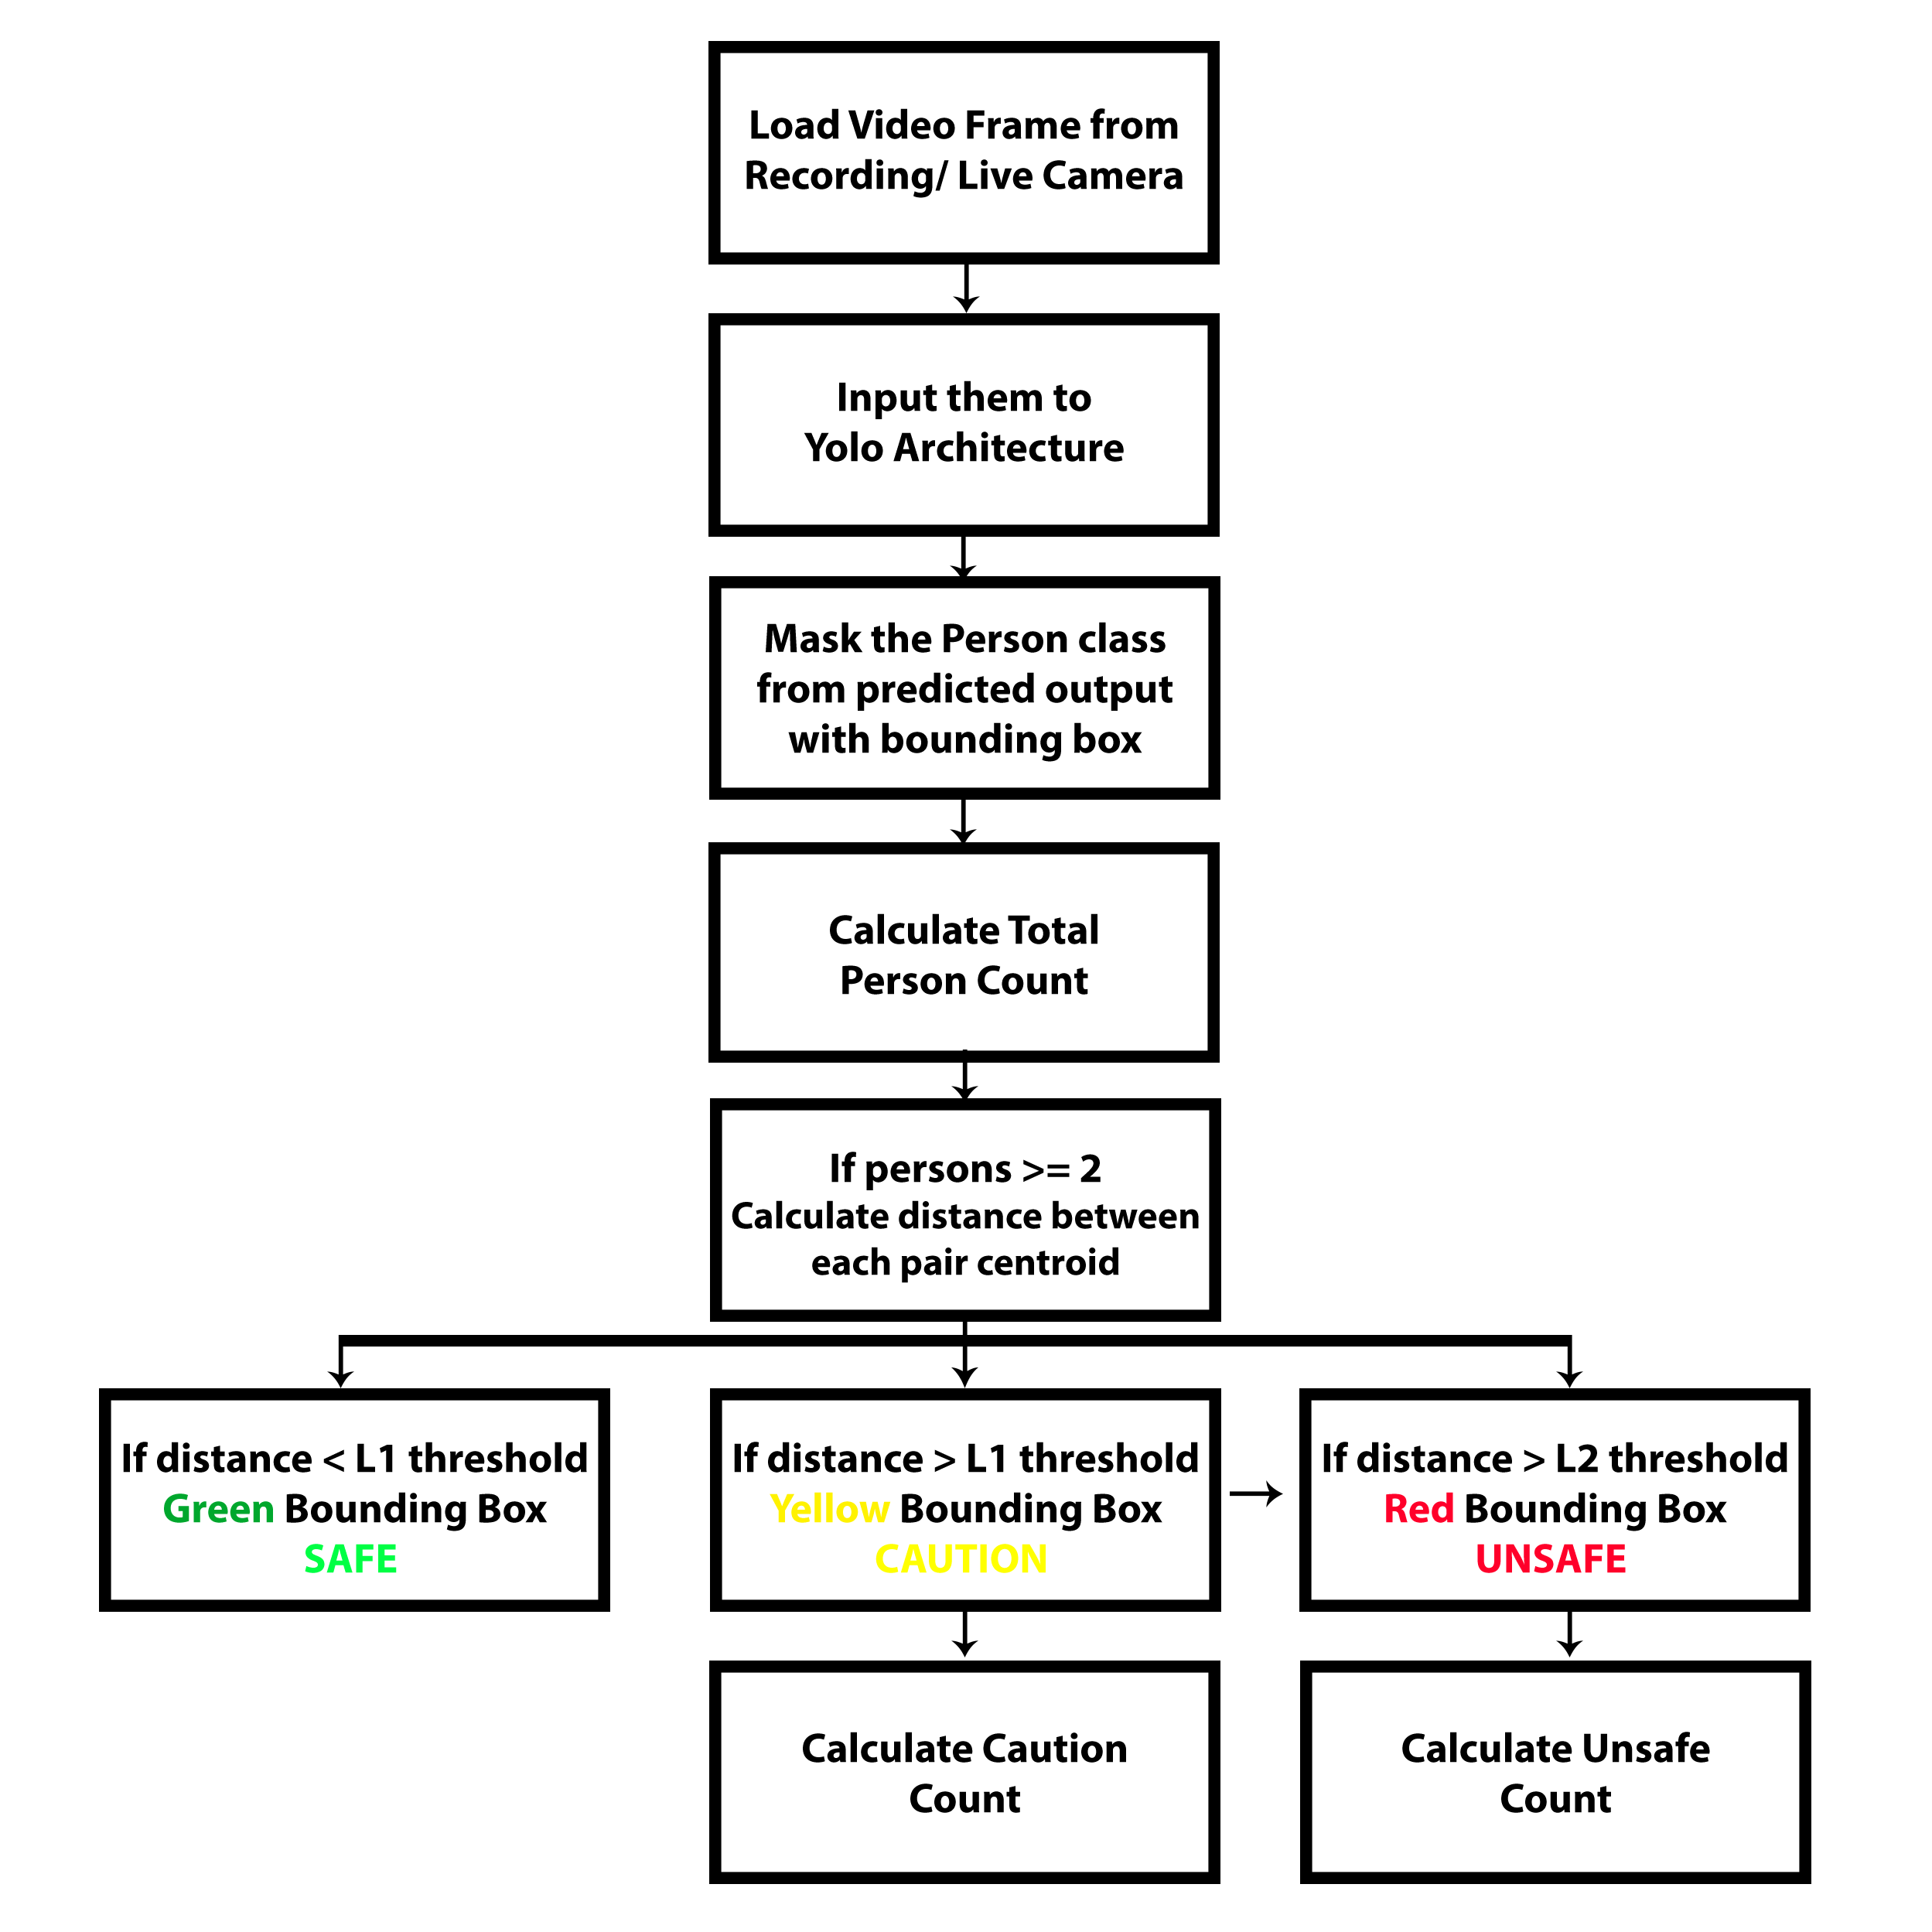
Workflow
Methodology

Slide 14
Results & Discussion
Models | FPS on Nano | mAP @IoU=0.5
yolov3-spp | 1.15 | 60.6
yolov3-288 | 1.15 | 52.1
yolov3-416 | 1.15 | 55.3
yolov3-608 | 1.15 | 57.9
yolov3-tiny 228 | 4.6 | 15
yolov3-tiny 416 | 4.6 | 20
yolov3-tiny 608 | 1.1 | 22.2
yolov4-288 | 1.15 | 62.8
yolov4-608 | 1.15 | 65.7
yolov4-tiny-288 | 7.3 | 34.1
yolov4-tiny-416 | 7.3 | 38.1

Slide 15
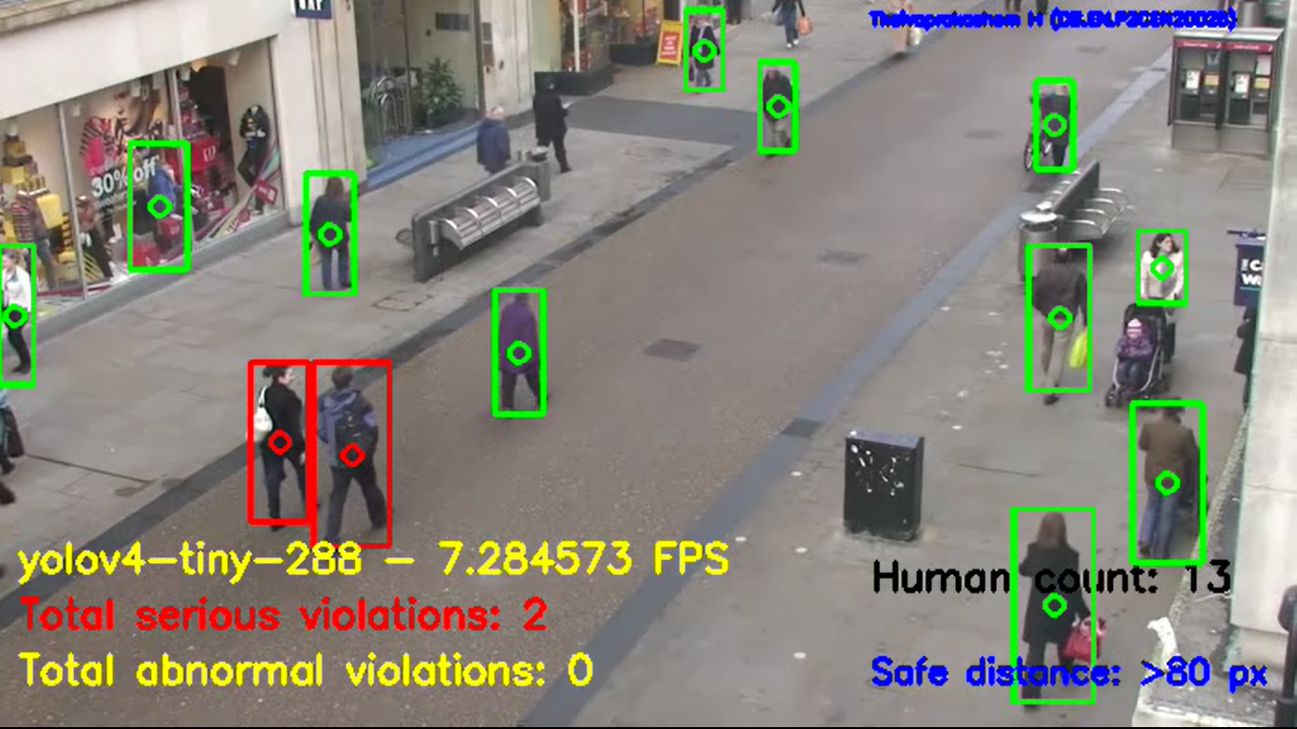
Results & Discussion

Slide 16
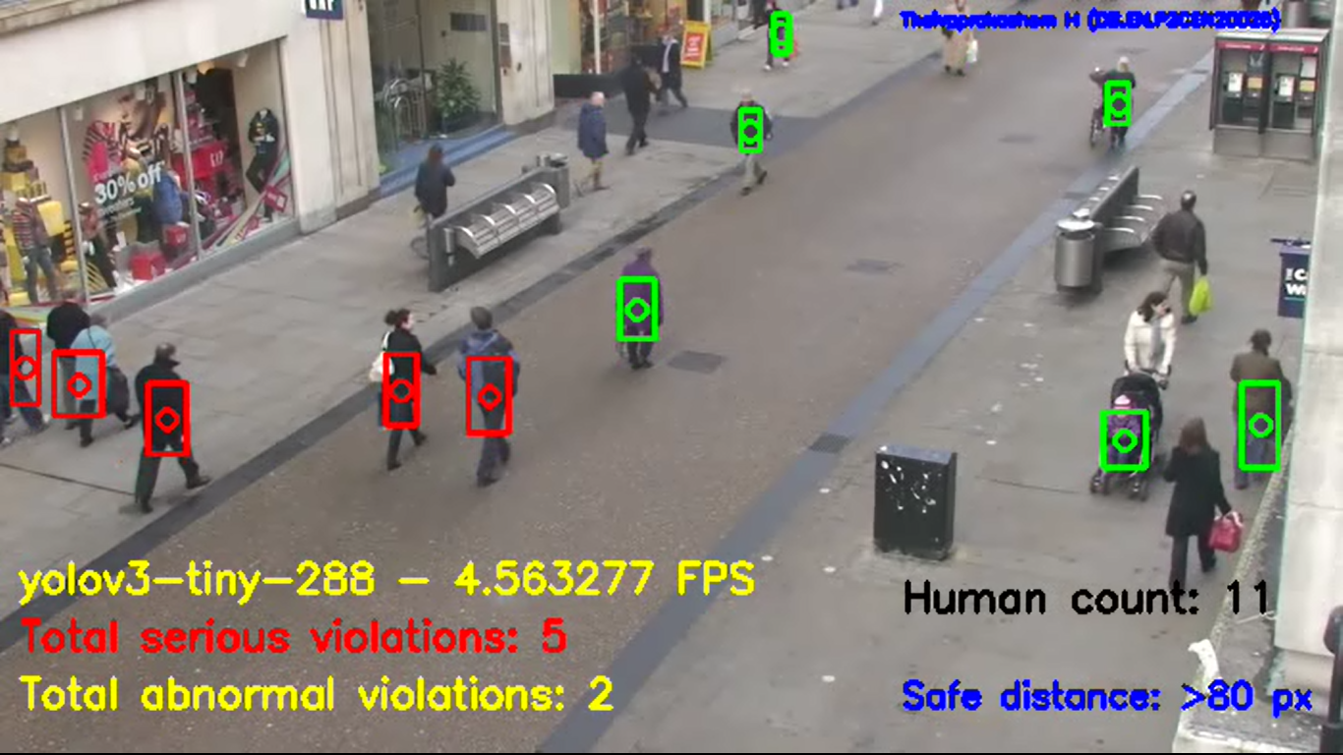
Results & Discussion

Slide 17
Results & Discussion

Slide 18
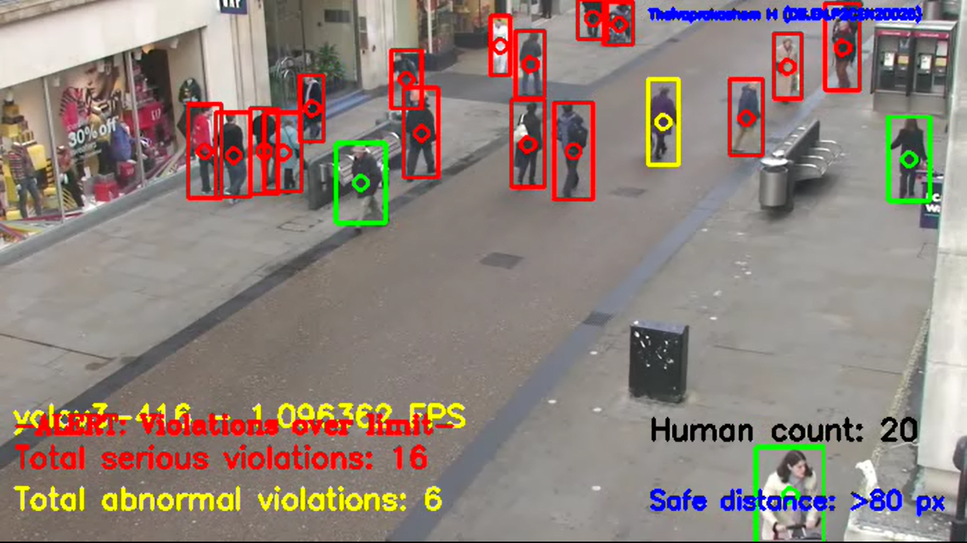

Slide 19
Challenges
No direct pixel to distance mapping readily available
Setting the pixel threshold value is quite challenging as it depends on the position of the camera elevation
Camera should be mounted at a higher elevation to give birdeye-view
Low FPS may not be very useful for critical real-time applications

Slide 20
Future Work
Implementation of other Object detection Architectures
Validation of Single Shot Detectors(SSD), RetinaNet, Faster RCNN and EfficientDet
Exploring TensorRT
Porting our existing object detection variants with NVIDIA TensorRT to get INT8 and FP16 optimizations
Alternative metric to detect social-distance
Stereographic projection/multiple video stream 3D mapping with new metrics
Real-time notification alert system
Value additions like automated message notification through Bots, Email-alerts and SMS alerts using Internet of Things and GSM technology.

Slide 21
Selected References
Ahamad, A.H., Zaini, N., Latip, M.F.A., 2020. Person Detection for Social Distancing and Safety Violation Alert based on Segmented ROI, in: Proceedings - 10th IEEE International Conference on Control System, Computing and Engineering, ICCSCE 2020. Institute of Electrical and Electronics Engineers Inc., pp. 113–118. https://doi.org/10.1109/ICCSCE50387.2020.9204934
Hou, Y.C., Baharuddin, M.Z., Yussof, S., Dzulkifly, S., 2020. Social Distancing Detection with Deep Learning Model, in: 2020 8th International Conference on Information Technology and Multimedia, ICIMU 2020. Institute of Electrical and Electronics Engineers Inc., pp. 334–338. https://doi.org/10.1109/ICIMU49871.2020.9243478
Keniya, R., Mehendale, N., 2020. Real-Time Social Distancing Detector Using Socialdistancingnet-19 Deep Learning Network. SSRN Electron. J. https://doi.org/10.2139/ssrn.3669311
Rusli, M.E., Yussof, S., Ali, M., Abobakr Hassan, A.A., 2020. MySD: A Smart Social Distancing Monitoring System, in: 2020 8th International Conference on Information Technology and Multimedia, ICIMU 2020. Institute of Electrical and Electronics Engineers Inc., pp. 399–403. https://doi.org/10.1109/ICIMU49871.2020.9243569
https://www.pyimagesearch.com/2020/06/01/opencv-social-distancing-detector/
https://www.analyticsvidhya.com/blog/2020/05/social-distancing-detection-tool-deep-learning/

